Slide 1

Lift Log
Logging them lifts, cataloging those gainz
The High Five
David Ralston (SM)
Ishan Pathirana
Rahul Arora(PO)
Scott Zin
Yotam Golan

Slide 2
Lift Log
Get Fit
Track Progress
Custom Workouts
Intuitive Interface
Workout Guidance
Pre-planned programs

Slide 3

Scope
Custom Profile
Build and Track Workouts
Workouts are Sets of Exercises
Exercises can be Compiled to Custom Workouts
Progress is Tracked and Suggestions Made

Slide 4

Sprint 1
Initial Commit
Design Login Page
Design Profile Page
As a User, I want to login
As a User, I want to create/edit my profile

Slide 5

Sprint 2
As a User, I want to see pre-made workouts
As a User, I want to select pre-made workouts
As a User, I want to navigate to different areas of the application
Design Workout Page
Design Exercise Page

Slide 6

Sprint 3
As a User, I want to track my workout progress/accompishments
As a User, I want to see body/workout statistics
As a User, I want to see workout modification suggestions
As a User, I want to transfer information between devices

Slide 7

Sprint 4
As a User, I want to see a selection of available exercises
As a User, I want to compile exercises into a workout
As a User, I want to share a custom workout
As a User, I want to rate community created workouts

Slide 8
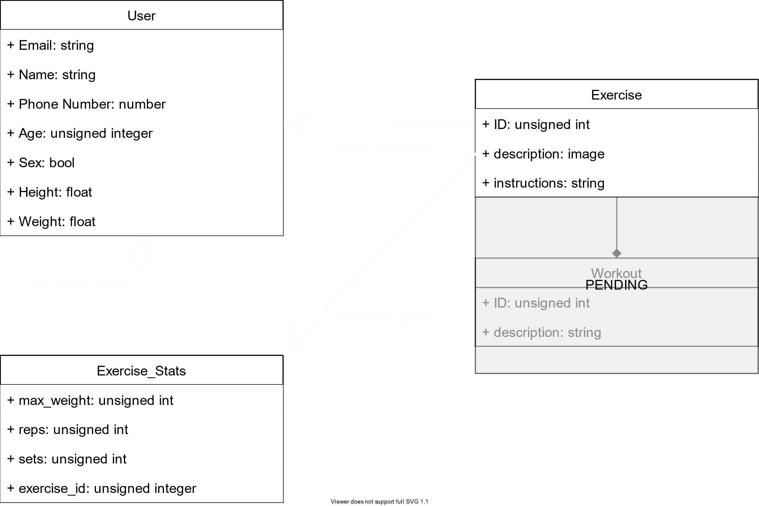
Architecture

Slide 9












Technologies
Languages
Database
Development Environment
Project Management
Design/Presentation

Slide 10

Challenges
UX/UI design
Unfamiliar technology
Potential feature creep

Slide 11
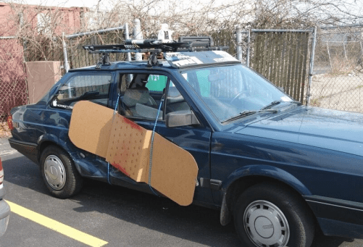
Minimum Viable Product
As a User I will be able to:
Login and edit my profile
Select and track a pre-made workout
Monitor progress

